Slide 1

PROJECT CARD [SKIP IF FAMILIAR]
EASY
ADVANCED

Slide 2
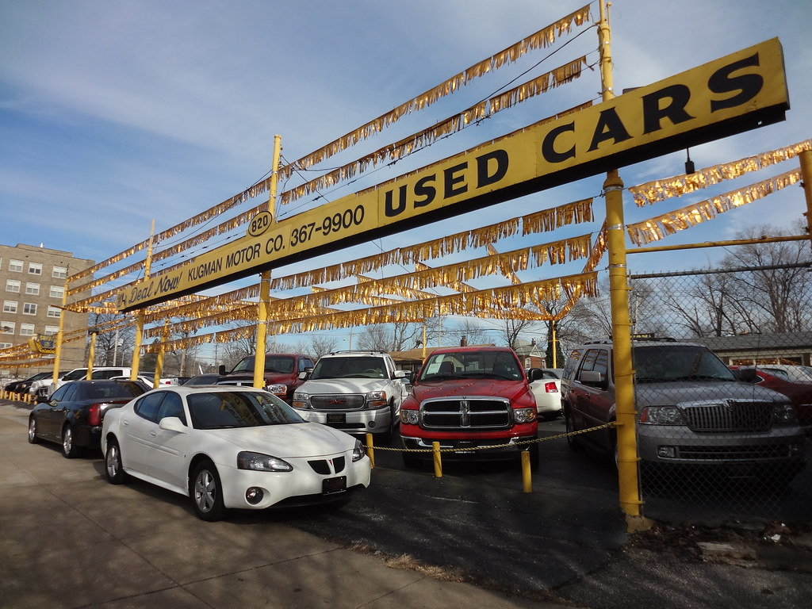
PROJECT CARD
GOAL:
Build, train, test and deploy a machine learning regression model to predict used car prices based on their features
TOOL:
AWS SageMaker Studio
PRACTICAL REAL-WORLD APPLICATION:
This project can be effectively used by car dealerships to predict used car prices and understand key factors that contribute to used car prices.
DATA:
INPUTS:
Make, Model, Type, Origin, Drivetrain, Invoice, EngineSize, Cylinders, Horsepower, MPG_City, MPG_Highway, Weight, Wheelbase, and Length
OUTPUT:
MSRP (Price)
Image Source: https://www.flickr.com/photos/pasa/6757993805
Dataset Source: https://www.kaggle.com/ljanjughazyan/cars1
Image Source: https://www.flickr.com/photos/pasa/6757993805
Dataset Source: https://www.kaggle.com/ljanjughazyan/cars1

Slide 3
INPUTS AND OUTPUTS
INPUTS
OUTPUT
MAKE
MODEL
TYPE
ORIGIN DRIVETRAIN ENGINESIZE CYLINDERS
HORSEPOWER MPG CITY MPG HIGHWAY WEIGHT
WHEELBASE LENGTH
VEHICLE PRICE (MSRP)
ML MODEL

Slide 4
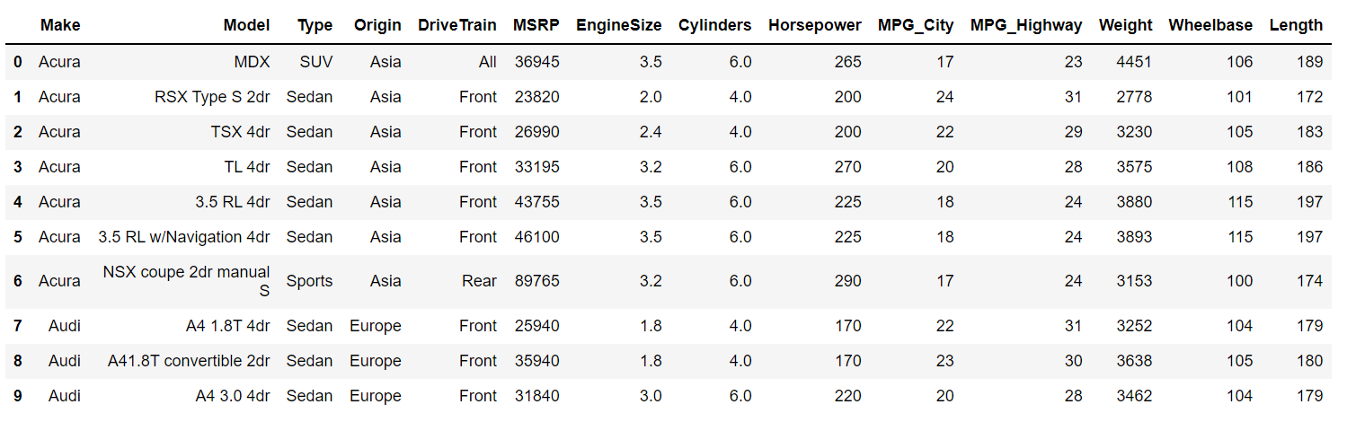
DATA OVERVIEW
MODEL OUTPUT: MSRP MANUFACTURER'S SUGGESTED RETAIL PRICE

Slide 5
CODE
DEMO
EASY
ADVANCED

Slide 6
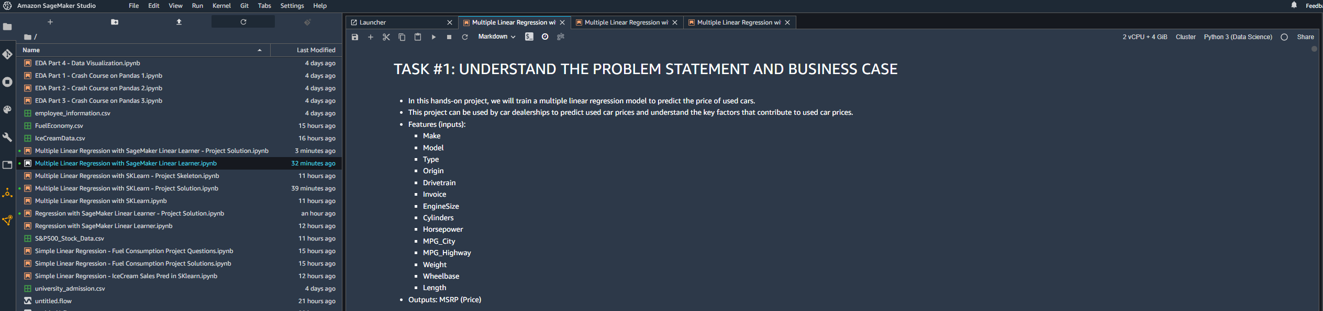
CODE DEMO

Slide 7
END-OF-DAY CAPSTONE PROJECT
EASY
ADVANCED

Slide 8
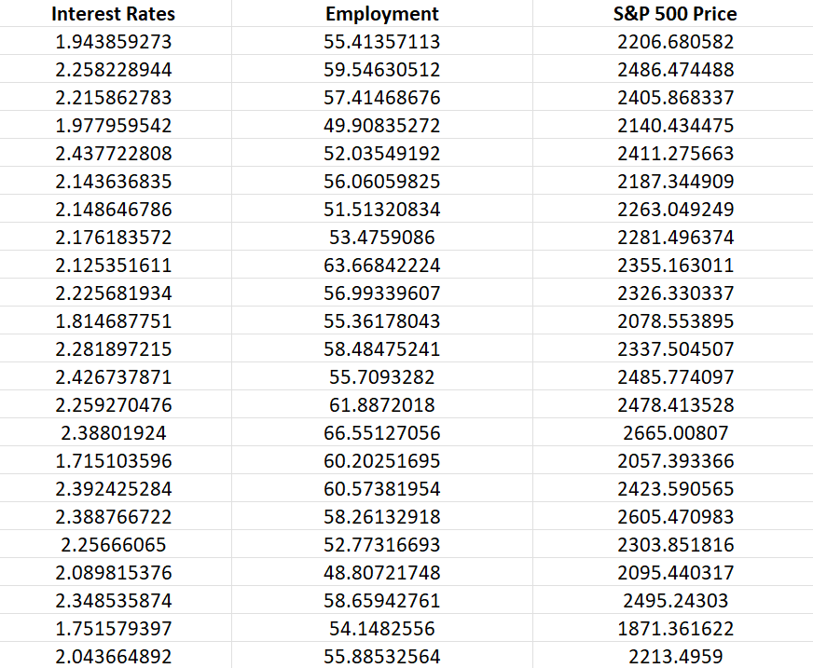
PROJECT
We would like to predict the S&P500 Price using interest rate and employment using Amazon SageMaker Linear Learner algorithm.
Independent variable X: Interest Rate and Employment
Dependent variable Y: S&P 500 Price

Slide 9
PROJECT TASKS
Using AWS SageMaker Linear Learner, perform the following:
1. Upload the “S&P500_Stock_Data.csv” dataset into S3
2. Split the data into 80% for training and 20% for testing
3. Train a machine linear regression model using SageMaker SDK
4. Deploy trained model as an endpoint
5. Assess trained model performance, what is the RMSE?
6. Delete the endpoint

